Slide 1


WELCOME TO
JOBHUB

Slide 2
JOBS HUB
FRONT END

Slide 4
JOBS HUB
BACK END

Slide 5
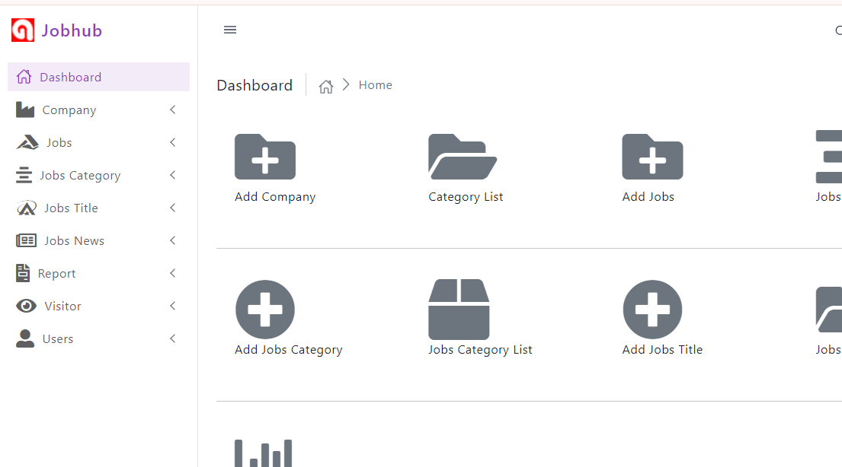

Slide 6
JOBSHUB-
DATABASE SCHEMA

Slide 7
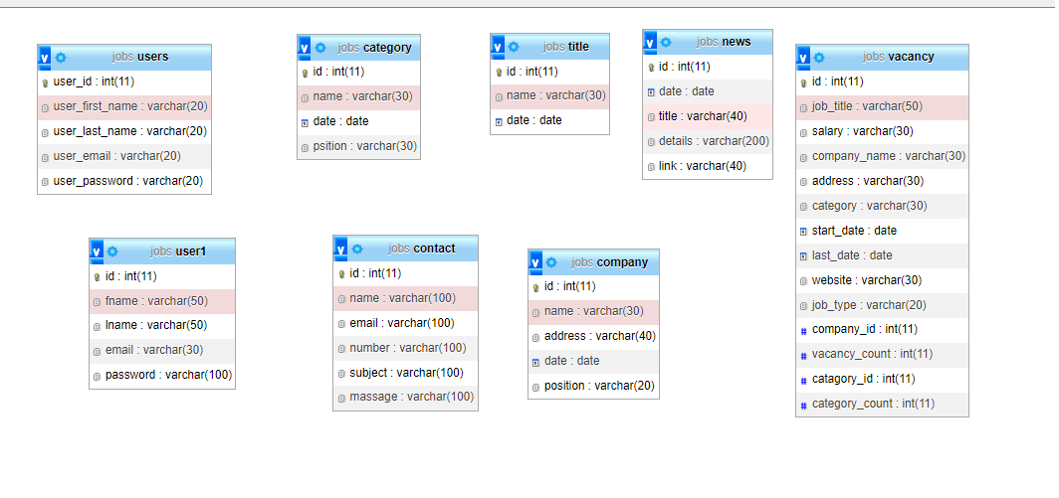

Slide 8
BACKEND –
ADMIN LOGIN

Slide 9
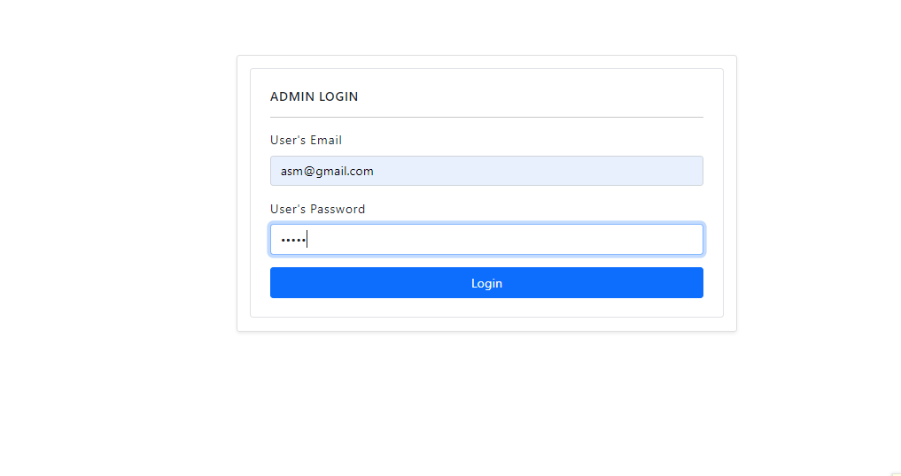

Slide 10
BACKEND –
DASHBOARD

Slide 12
BACKEND -
ADD COMPANY

Slide 13
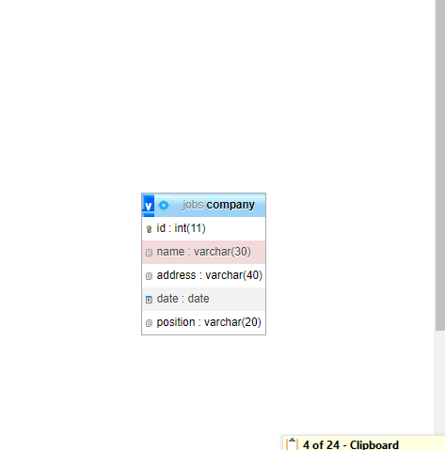

Slide 14
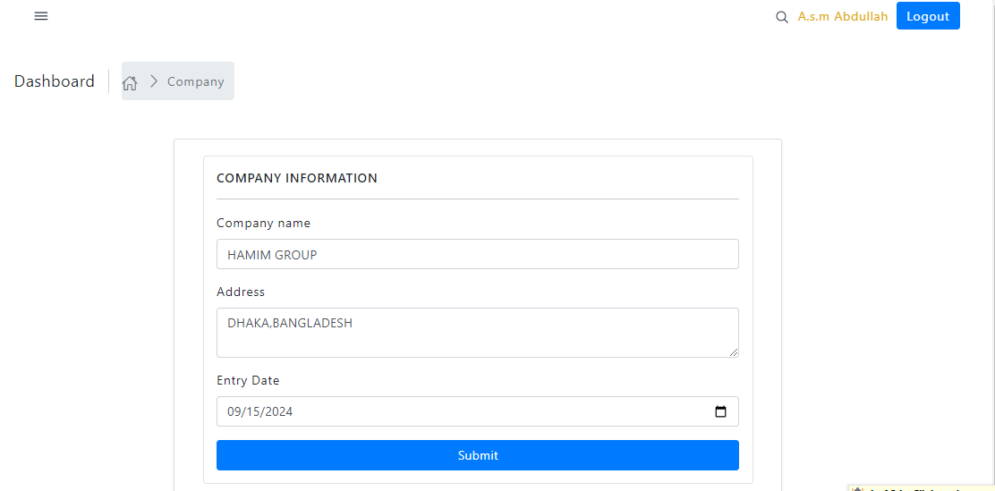

Slide 15
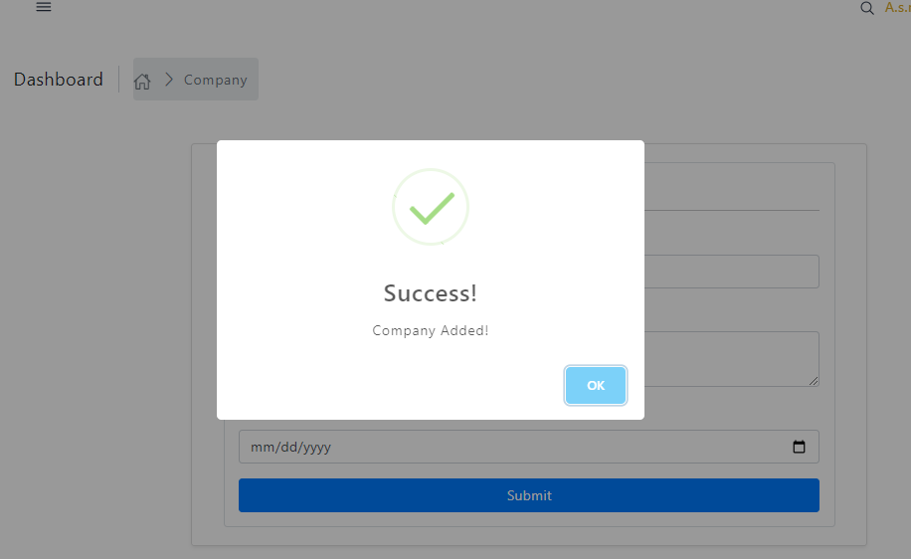

Slide 16
FRONT END -
COMPANY PAGE

Slide 17
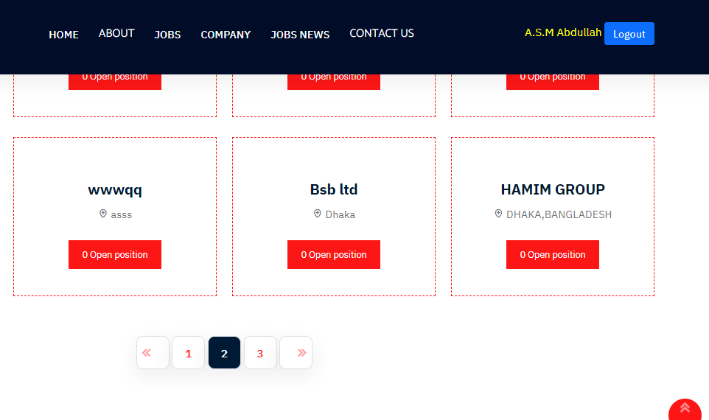

Slide 18
BACKEND -
COMPANY MANAGE

Slide 19
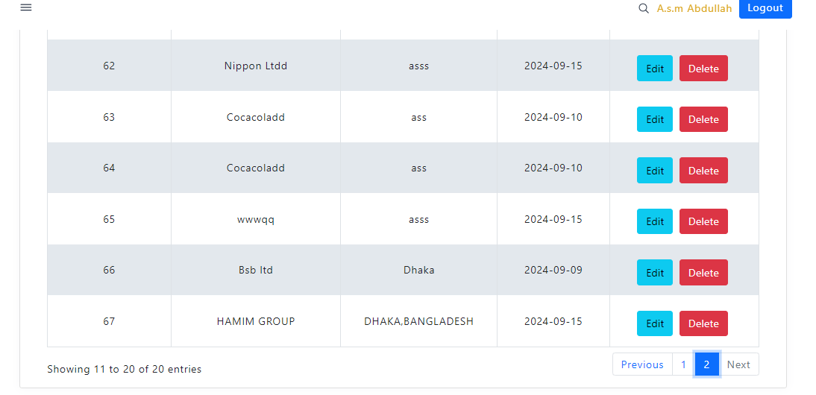

Slide 20
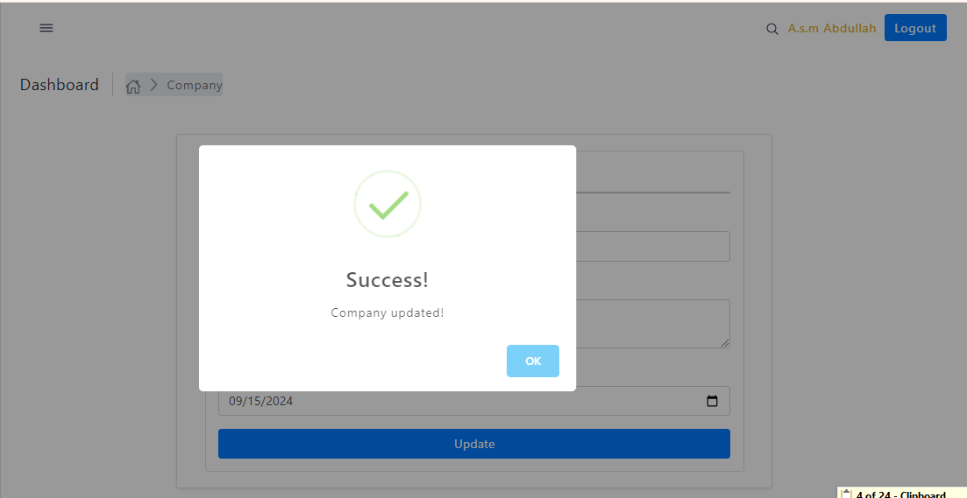

Slide 21
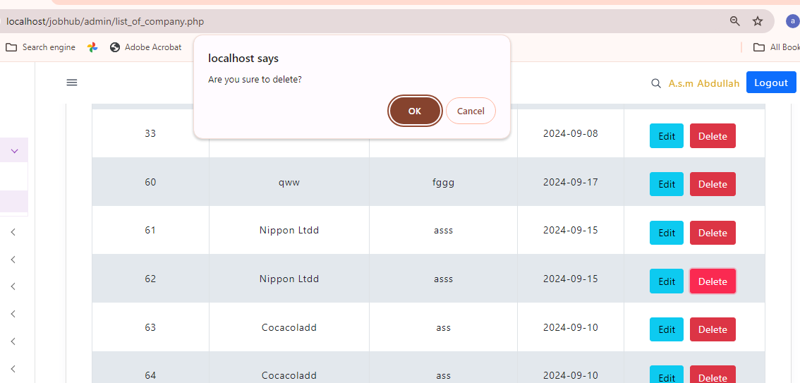

Slide 22
BACKEND -
ADD CATAGORY

Slide 23
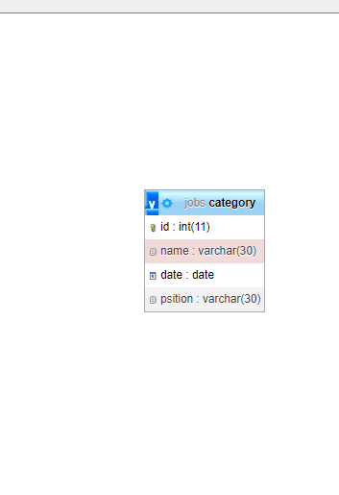

Slide 24
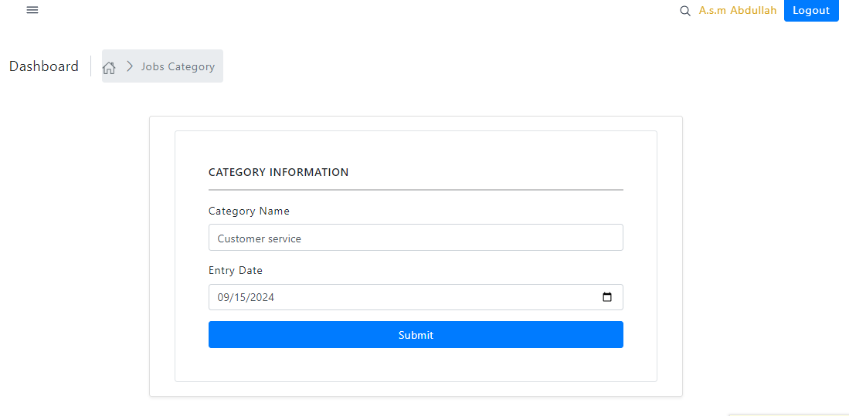

Slide 25
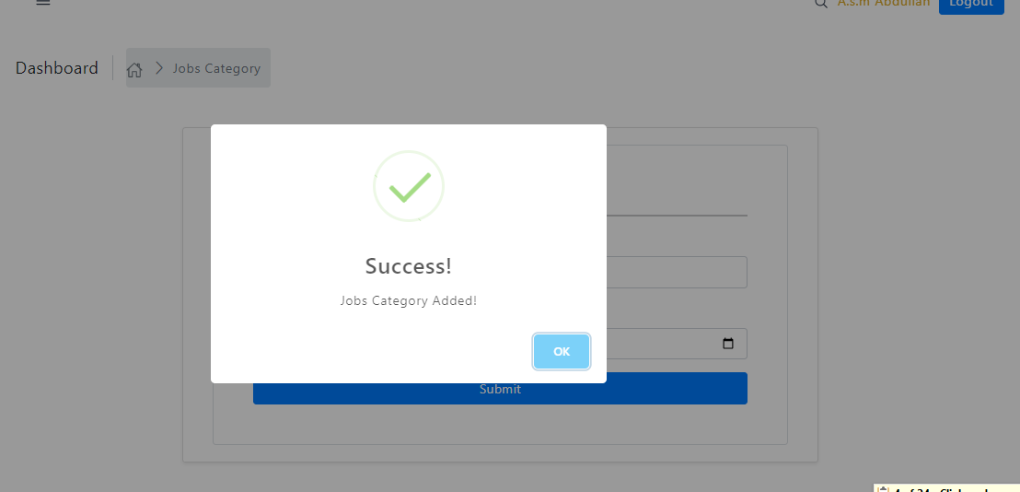

Slide 26
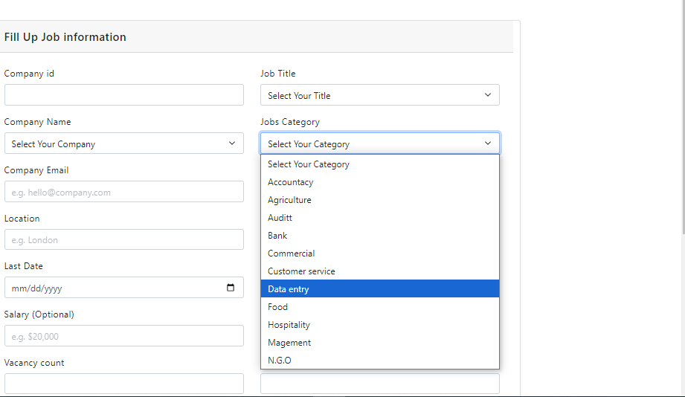

Slide 27
FRONT END -
CATAGORY

Slide 28


Slide 29
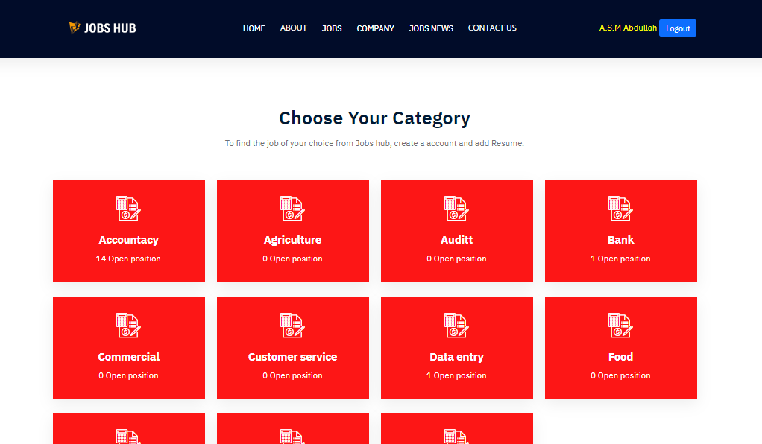

Slide 30
BACKEND -
CATEGORY MANAGE

Slide 31
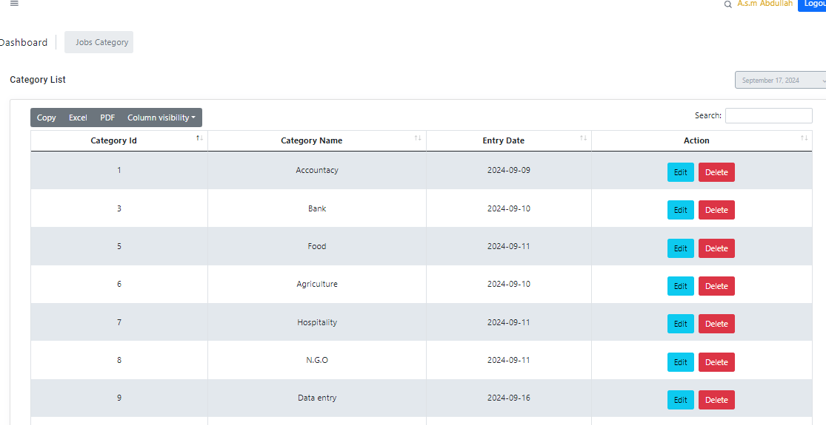

Slide 32
BACKEND -
JOBS TITLE

Slide 33
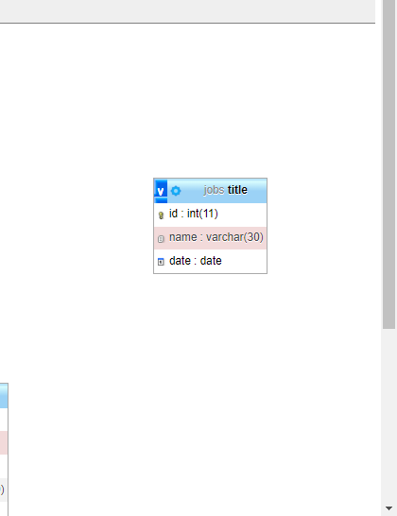

Slide 34
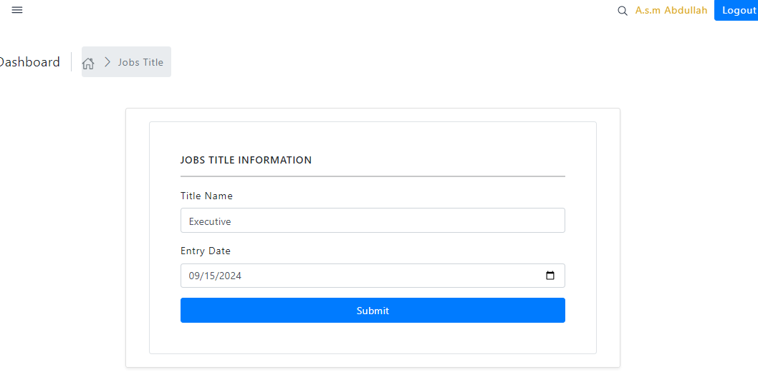

Slide 35
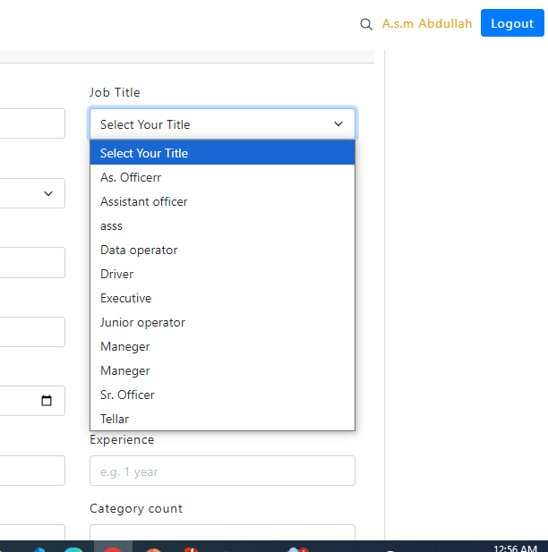

Slide 36
BACKEND -
JOBS TITLE MANAGE

Slide 37
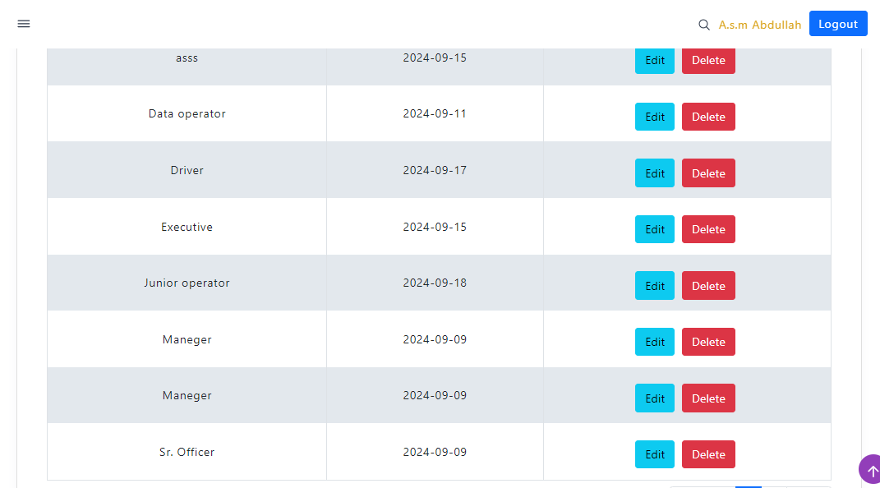

Slide 38
BACKEND -
POST A JOB

Slide 39
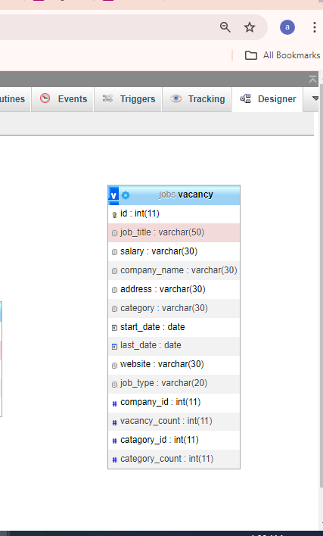

Slide 40
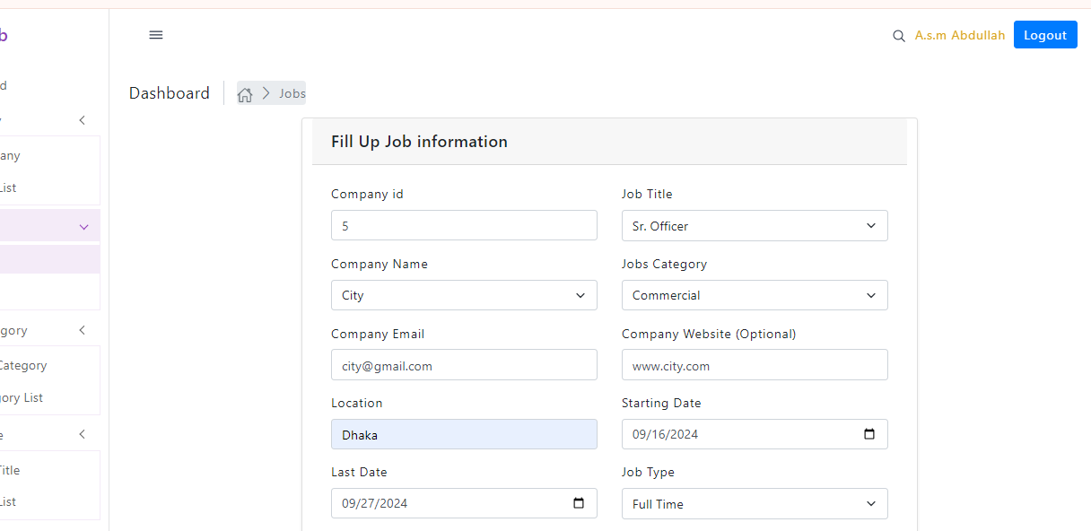

Slide 41
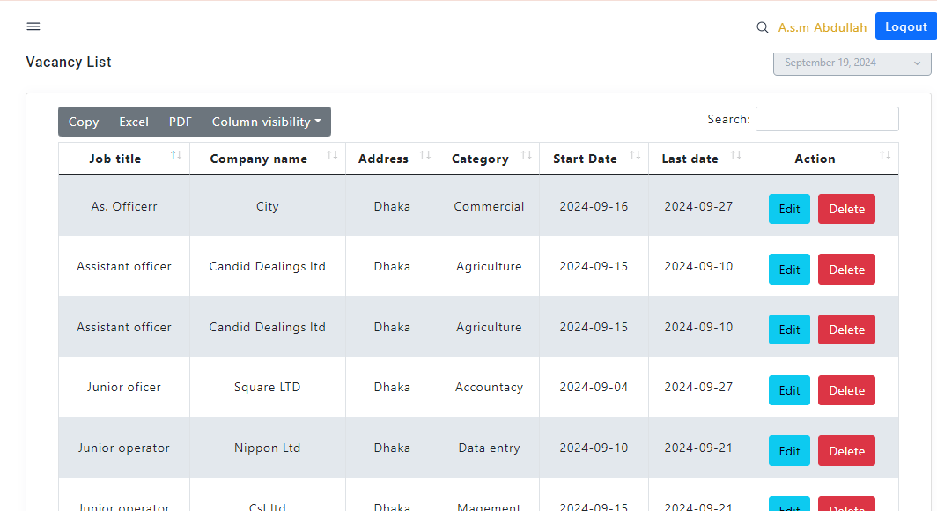

Slide 42
FRONTEND -
POST A JOB

Slide 43
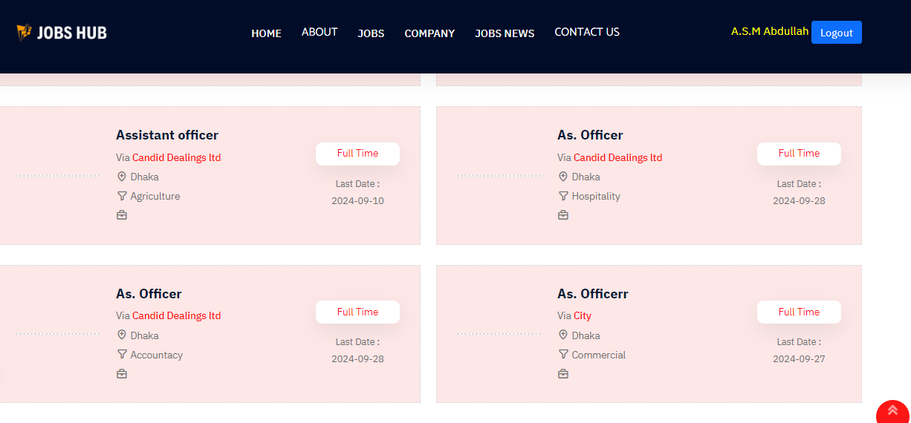

Slide 44
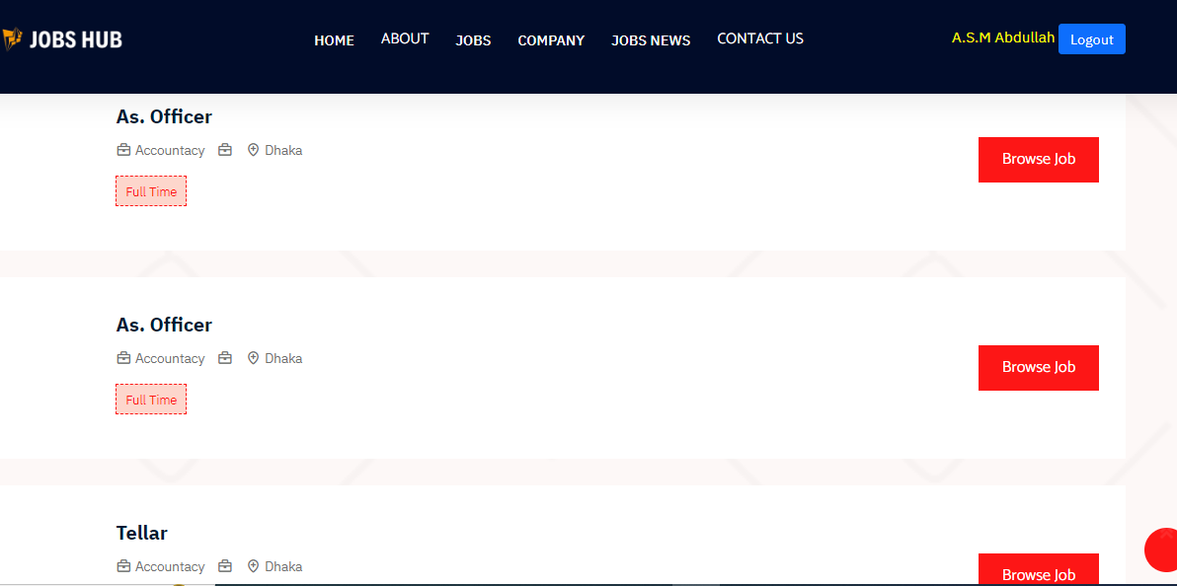

Slide 45
BACKEND -
POST A JOB MANAGE

Slide 46
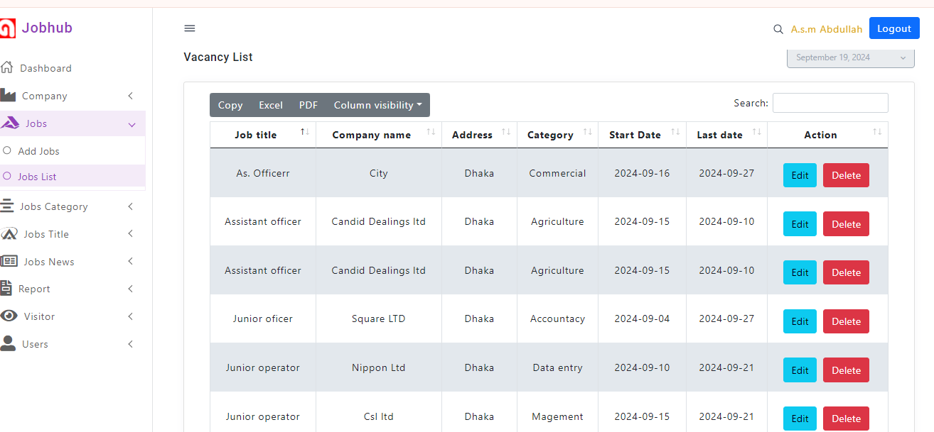

Slide 47
BACKEND -
JOBS NEWS

Slide 48
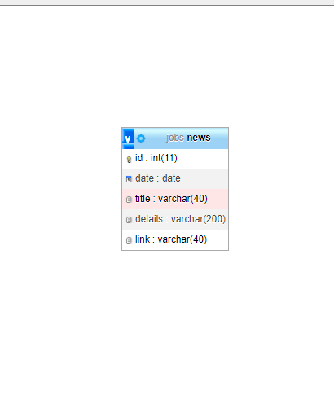

Slide 49
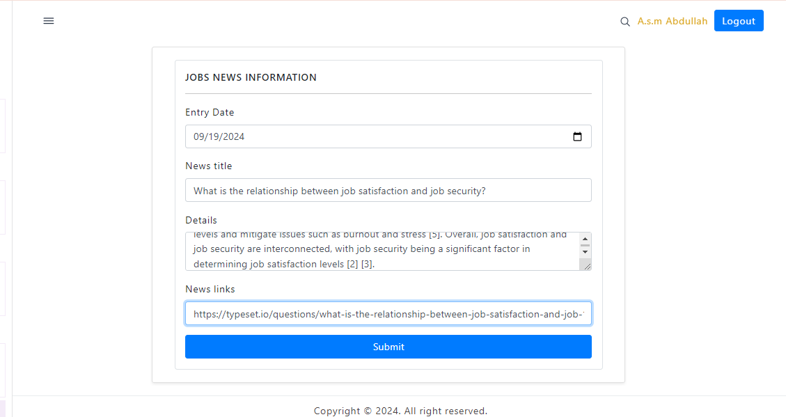

Slide 50
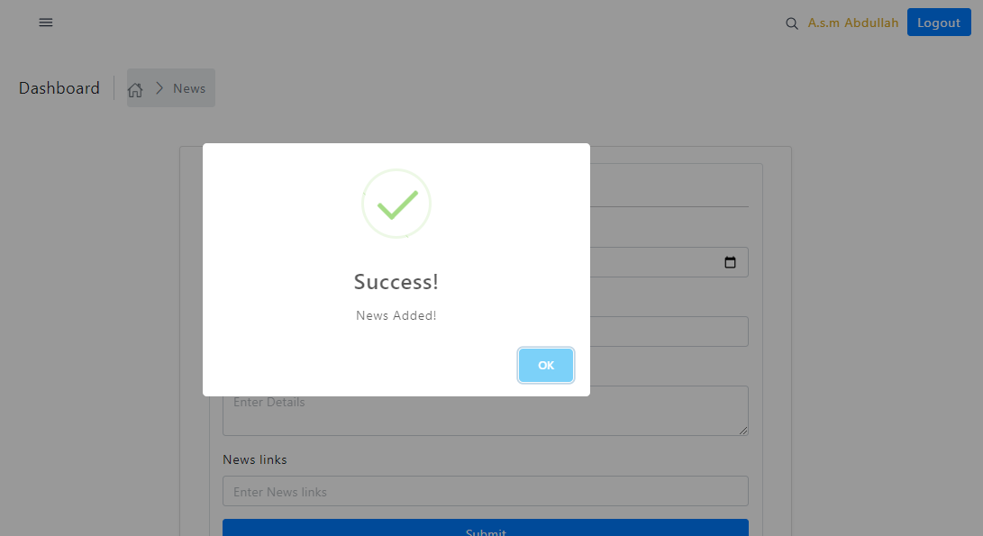

Slide 51
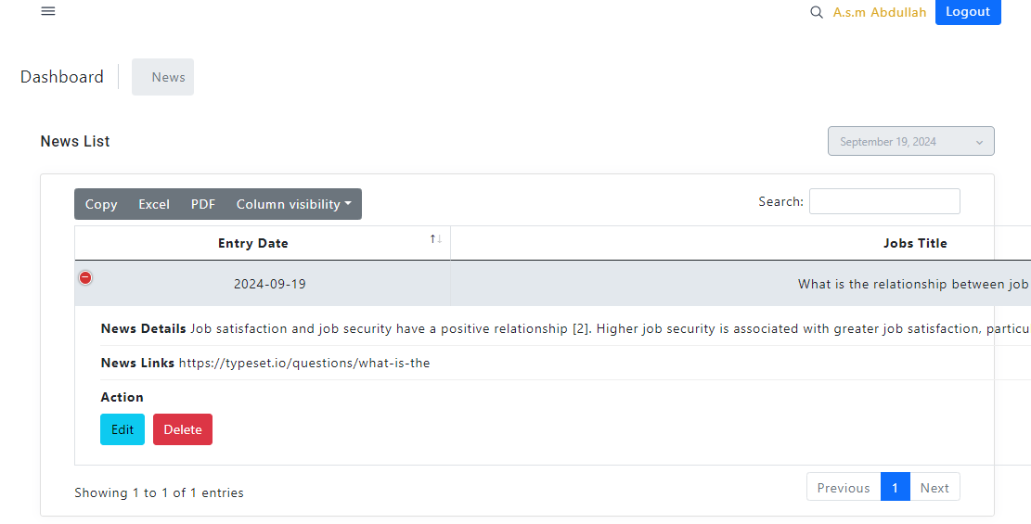

Slide 52
FRONTEND -
JOBS NEWS

Slide 53
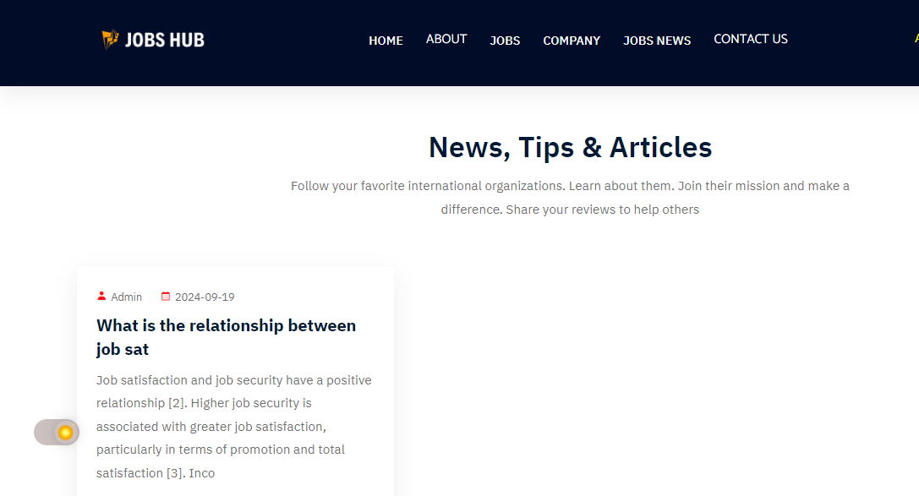

Slide 54
BACKEND -
JOBS REPORT

Slide 55
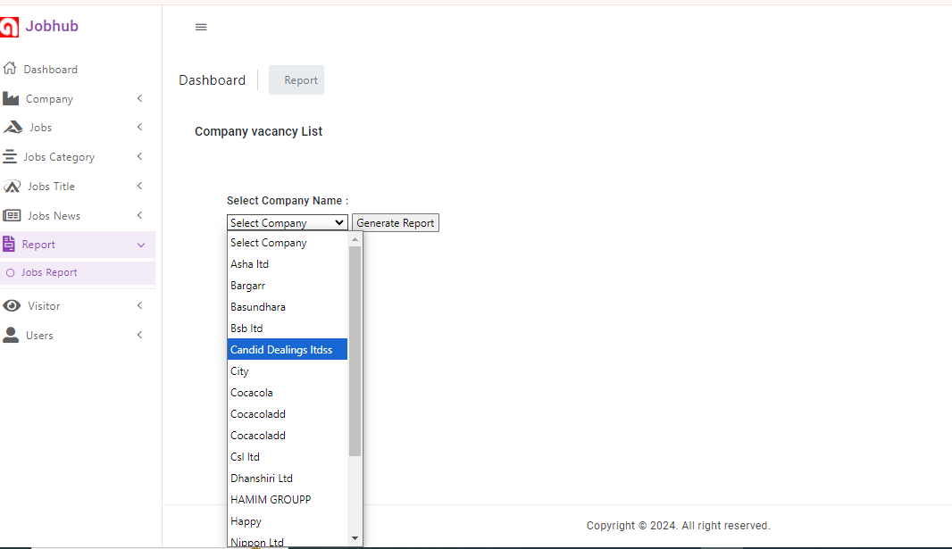

Slide 56
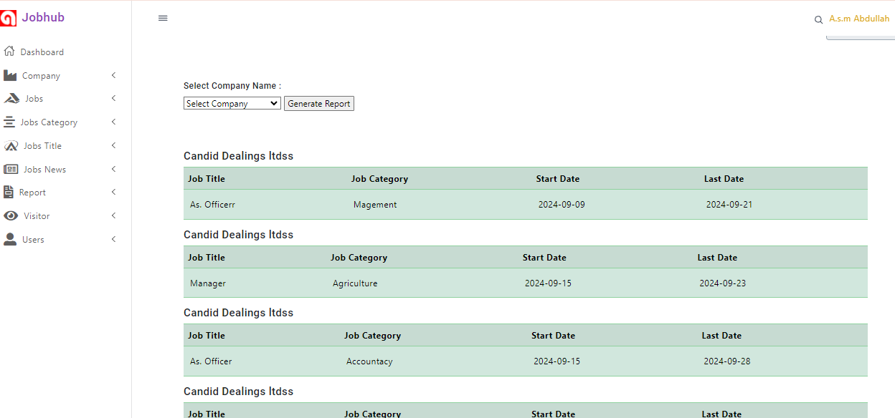

Slide 57
FRONTEND -
CONTACT

Slide 58
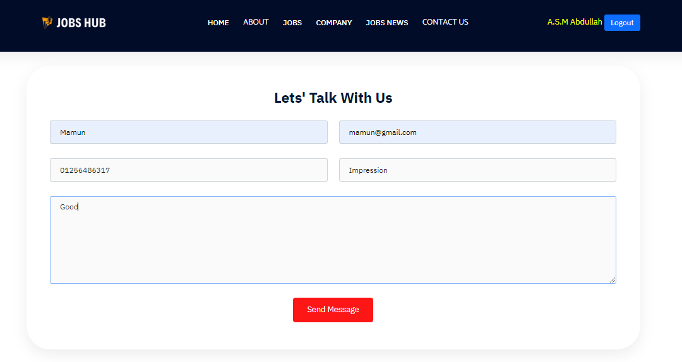

Slide 59
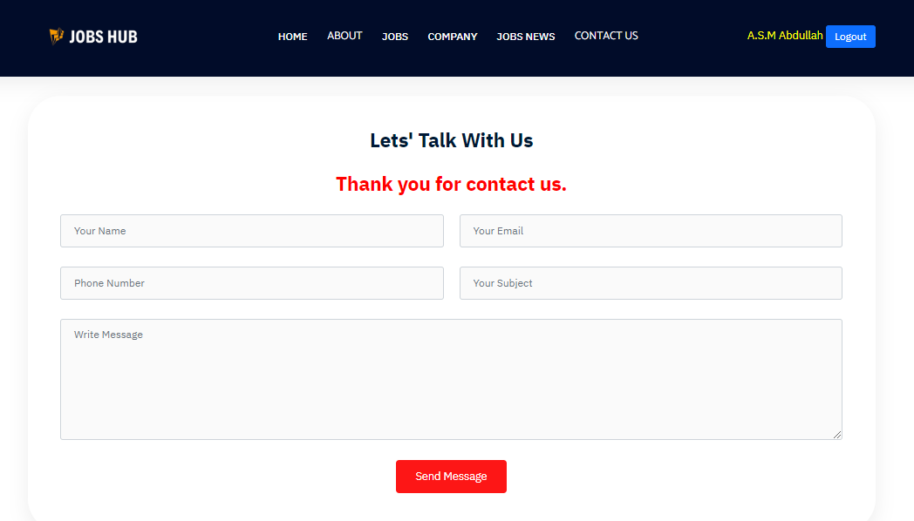

Slide 60
BACKEND -
CONTACT

Slide 61
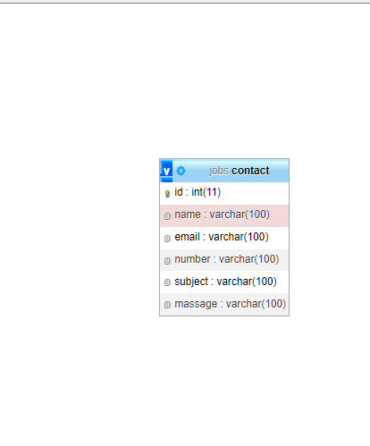

Slide 62
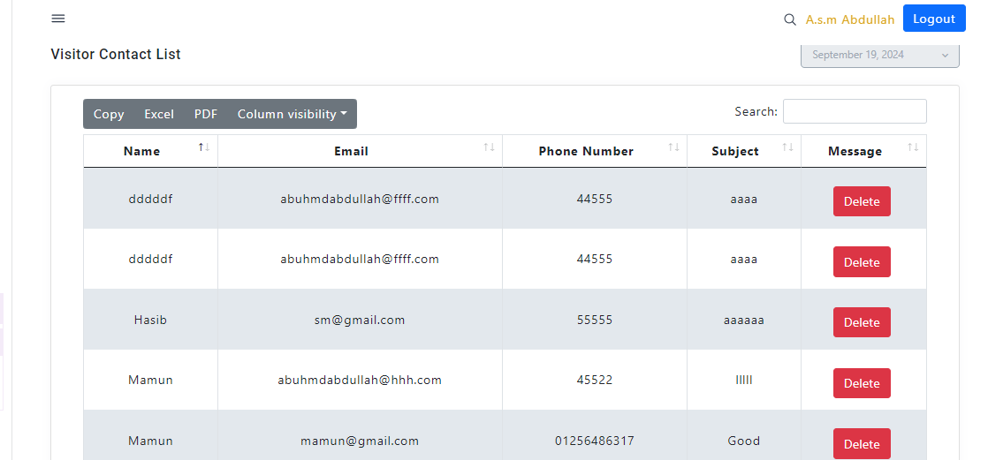

Slide 63
FRONTEND -
SIGN UP

Slide 64
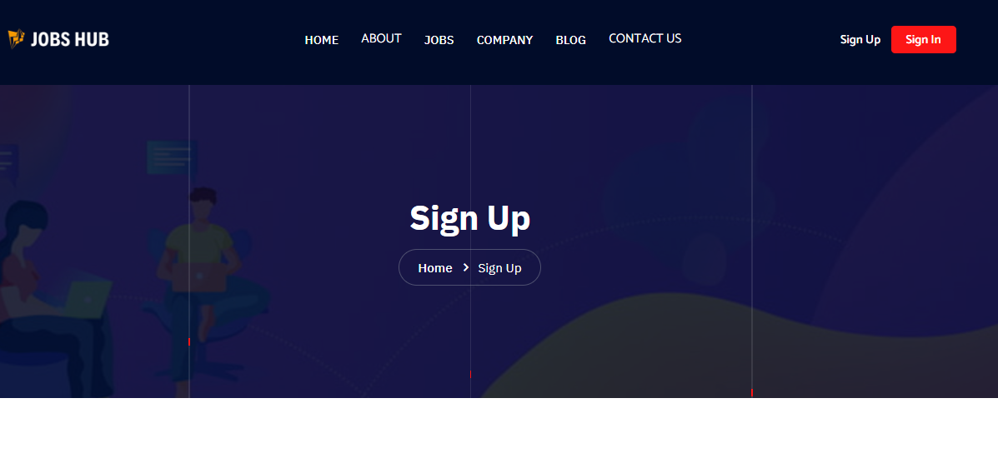

Slide 65
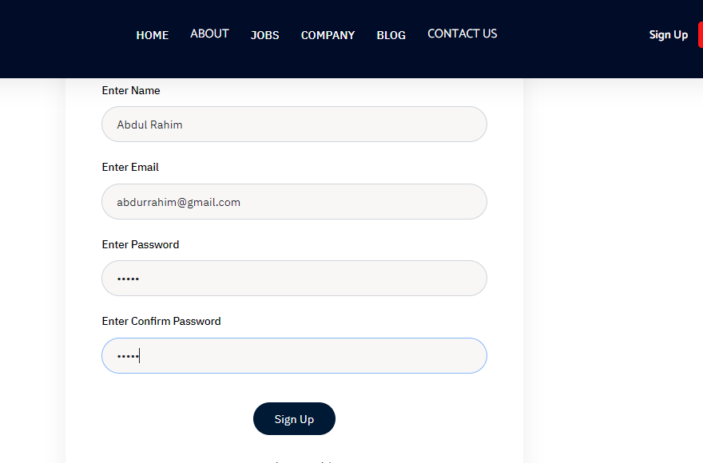

Slide 66
FRONTEND -
SIGN IN

Slide 67


Slide 68
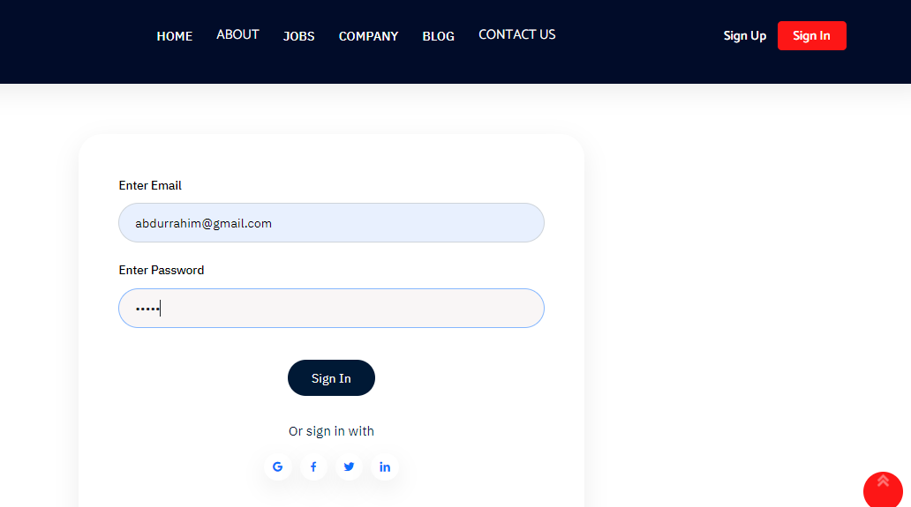

Slide 69


Slide 70
BACKEND -
FRONTEND SIGN UP

Slide 71
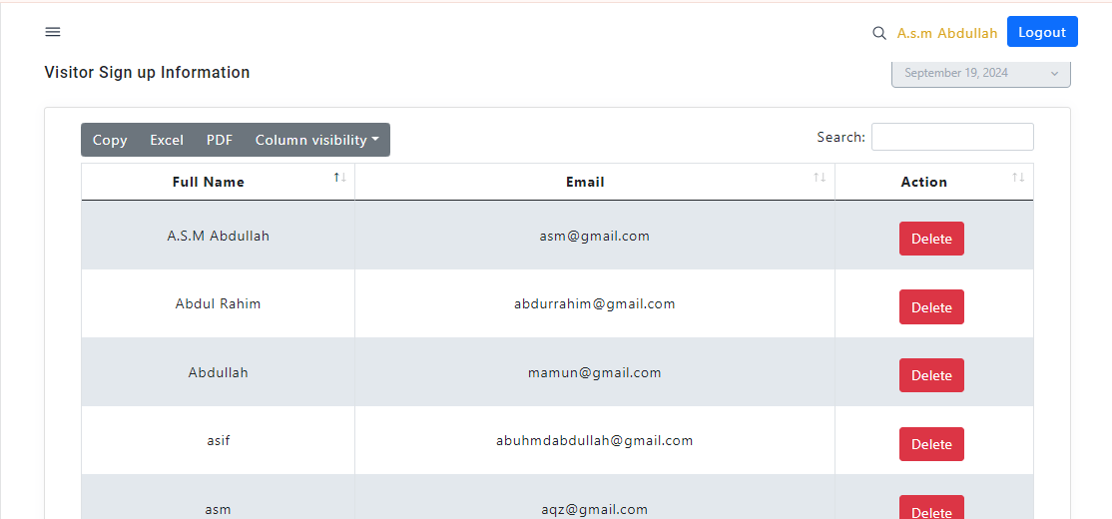

Slide 72
BACKEND -
USER SIGN UP

Slide 73
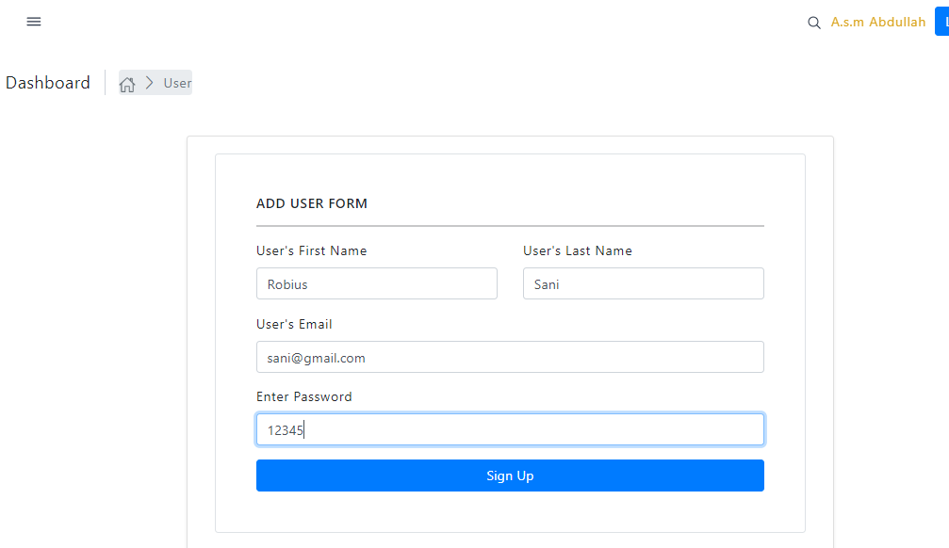

Slide 74
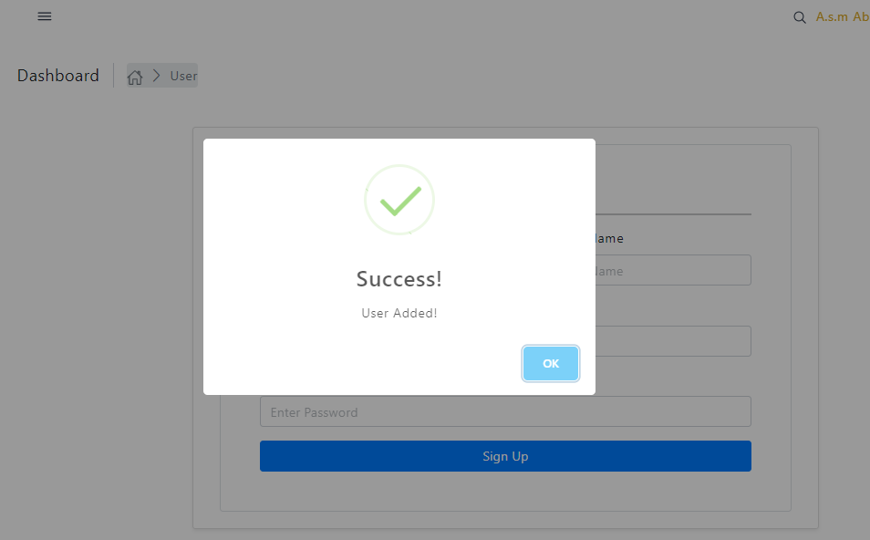

Slide 75
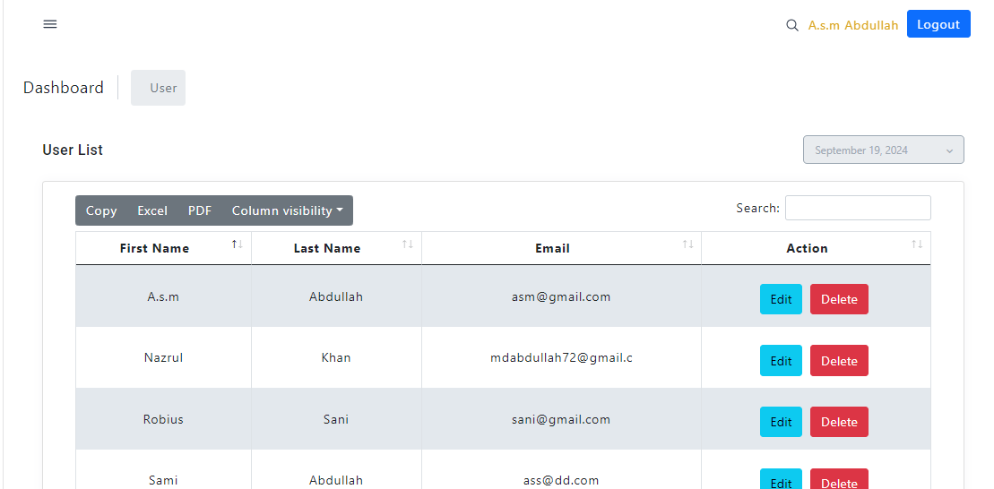

Slide 76
BACKEND -
ADMIN LOGIN

Slide 77
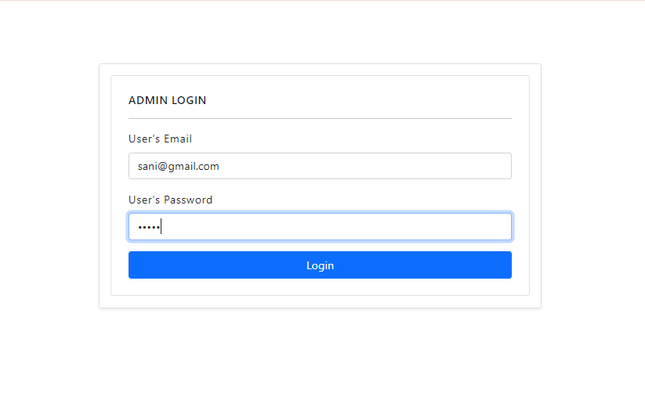

Slide 78
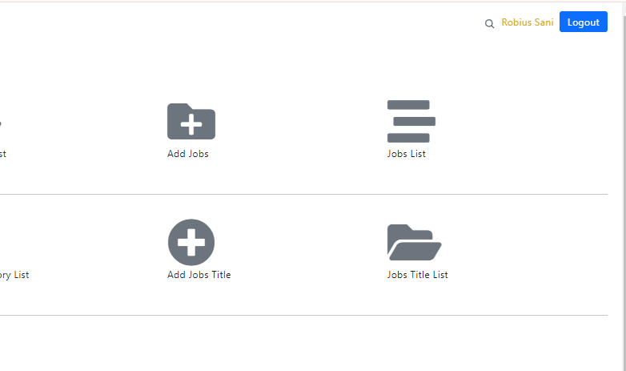

Slide 79
THIS END IS NOT FOREVER
THIS IS JUST BEGUN
LET’S GO START!!!!!

